Slide 1


$The β_{eta }$ $Firm$
AN EXPLORATORY ANALYSIS OF EMPLOYEE ENGAGEMENT & PREDICTIVE ATTRITION
Camille Howard, John Yan, Sara Zaheri
Notes:
CAMILLE: Good evening. We are the Beta Firm. We are excited to present you with our findings regarding DDS Analytics. Let’s take a look at our objectives

Slide 2

Business objectives
DDS Analytics hired our firm to assess the following areas for the existing population:
Top reasons for employee turnover
Analyze role-specific trends regarding job satisfaction
Identify any unique observations
Notes:
CAMILLE

Slide 3
Demographic profile
Gender | Average Age
Female | 37.4
Male | 36.7
Gender | Average Tenure
Female | 7.2 years
Male | 6.8 years
Gender | Average Years Working
Female | 11.8 years
Male | 11 years
Notes:
CAMILLE: Before we get started, lets take a look at a few descriptive statistics about the population. We chose to focus on the demographic profile from a gender based perspective because we felt it would be useful in understanding the perspectives of each population, rather than looking at the company as a whole. Analyzing from this perspective also allows you to consider whether there are any gender specific engagement initiatives the company may want to consider
The total employee population consists of 1,462 employees, with an average age of 37, tenure of 7 years and average years working experience of 11 years. This is not an inexperienced work population. Many appear to be mid-career Therefore, retention should be pretty consistent throughout the organization.

Slide 4
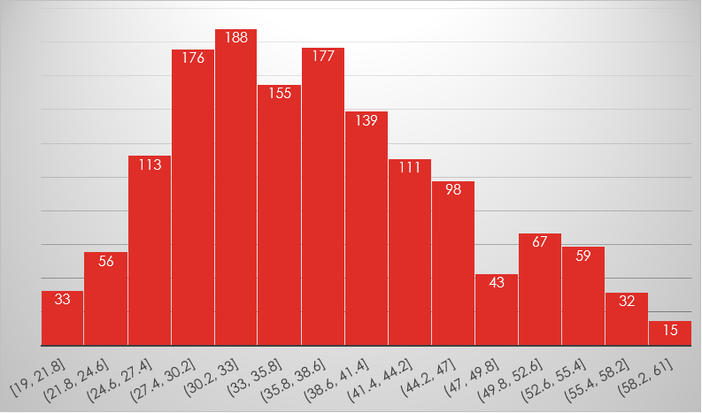
Employee age distribution
Notes:
CAMILLE: In terms of age distribution, there is a healthy age distribution. This is important because it allows the organization to consider its talent pipeline and to ensure they have a healthy succession planning program in place.

Slide 5
Education level by gender
Notes:
CAMILLE:This is a highly educated population, which should further strengthen the organizations talent pipeline. Given such an educated workforce, it will be important to ensure there are adequate advancement opportunities in the organization. If the organization fails to address this, they may be subject to poaching by competitors.

Slide 6
Demographic profile
Notes:
Finally, from a demographic perspective we analyzed the marital status of the employee population. There was nothing statistically significant to consider between males and females. Are there any questions about the demographic profile of the organization?

Slide 7


Leadership
Notes:
CAMILLE: I will now turn it over to John to discuss leadership trends in the organization.

Slide 8
Leadership roles by gender
Notes:
JOHN: One of the key parameters we were asked to analyze was to consider whether there were any specific data trends by role in the organization. This slide provides you a great overview of the roles identified as management roles in the organization. <NEXT SLIDE>

Slide 9
Trends in job satisfaction
Notes:
JOHN:As we delved deeper into the organization, we understood one of the most important factors you wanted considered was trends in job satisfaction.
We analyzed job satisfaction in all roles in the organization. Interestingly we found that job satisfaction was rated lowest by women in management positions, compared to men. The average job satisfaction for women overall was 2.67 out of a 4 point scale, compared to 2.75 for men. Women are represented in red and men are represented in orange. This could be a great area for the organization to consider addressing.

Slide 10

Culture and retention
Notes:
JOHN: Next, we took a look at a few elements related to culture and how they could or could not impact retention. I’ll now turn it over to Sara to discuss what we found.

Slide 11
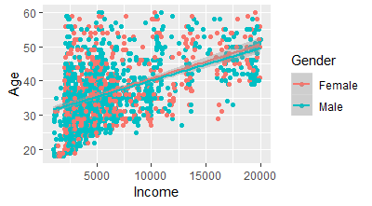
Correlation between age and income
Age and Income
P-value | < 2.2e -16
95% confidence Interval | 0.458 – 0.535
Correlation | 0.4978
Notes:
SARA: First we took a look at the relationship between age and income in the organization.
In order to find the relation between age and income, we created a scatter plot and colored each point based on the gender. Correlation value shows a descent relationship between age and income. In another word, in average, older employee have higher salary than younger one!

Slide 12
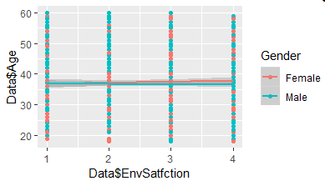
CORRELATION BETWEEN environmental SATISFACTION & GENDER
Age
Environmental Satisfaction Score
Notes:
SARA: Then, we were trying to investigate the relationship between life satisfaction (we used environment satisfaction as a representor of life satisfaction) and other parameters in the data. First we plotted the Age and environment satisfaction and it seems there is not any clear relationship between these two values!

Slide 13
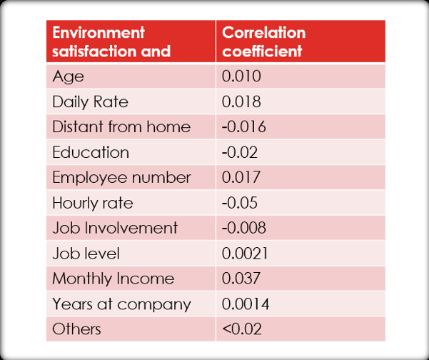
Correlation between environment satisfaction & other variables
Notes:
SARA: CORRELATION BETWEEN environmental SATISFACTION & OTHER PARAMETERS (New Slid)
When we dig into the data and calculate the correlation between environmental satisfaction with other data sets, we realize that there is not any discernible relationship between life satisfaction and other variables!
As you can see all correlation coefficient are small!

Slide 14

summary
Notes:
SARA: I will now turn it back over to John to discuss attrition and recommendations.

Slide 15
Top reasons for attrition
Female | Avg. | Male | Avg.
Relationship Satisfaction | 2.68 | Relationship Satisfaction | 2.72
2. Job Satisfaction | 2.71 | Job Involvement | 2.73
3. Work Life Balance | 2.76 | Job Satisfaction / Work Life Balance | 2.75
Notes:
JOHN

Slide 16
recommendations
SUCCESSION PLANNING will be key to future success
01
WOMEN IN LEADERSHIP conduct focus groups regarding the low satisfaction scores
02
BRAND POWER – Invest in the brand by promoting employee
03
TRAINING & DEVELOPMENT consider utilizing training as a tool to motivate and develop employees
04
Notes:
JOHN: Based on the data we analyzed, it’s evident the organization has a strong culture. The key to growth and retention in the future, will come down to growth opportunities at all levels of the organization.
While women are well-represented in leadership, the low job satisfaction average for women in this population could be a red flag.
The organization has a great mix of employees in all stages of their career. The organization should utilize this broad mix to promote the diversity of the company.
And finally, the average training opportunities in the last year was around 2.5 training opportunities for the year. Given the preponderance of highly degreed employees, training could be a great way to not only invest in employees, but it can be motivational as well. Employees will be able to see first hand the organizations commitment by having a robust training program.

Slide 17

conclusion
Dynamic workforce with a healthy demographic
Beware of external competition for Talent
Consider Job Rotation
Notes:
CAMILLE: In conclusion, DDS Analytics is a dynamic workforce with a demographic that is widely diverse in both age, gender and education. This is rare for a highly specialized technical company, where competition for talent is fierce. In order for DDS Analytics to remain competitive, they will have to ensure they create an environment where talent is treated as a competitive advantage.
Finally, there was a unique facet of the data we wanted to point out related to years in role. The industry average that employees spend in technical roles in organizations similar to DDS Analytics is 2.5 years. The average time in a specific role for DDS was 4 years. This is an area to be mindful of as you create processes and projects in the organization. You will want to ensure employees aren’t in roles too long where they become stagnant and lack engagement.
We feel DDS Analytics is a great organization for you to pilot and develop your first application for talent management related to predictive attrition. Are there any questions?
Thank you for your time.

